Slide 1
Chapter 2: Operating-System Structures

Slide 2
Chapter 2: Operating-System Structures
Operating System Services
User Operating System Interface
System Calls
Types of System Calls
System Programs
Operating System Design and Implementation
Operating System Structure
Operating System Debugging
Operating System Generation
System Boot

Slide 3
Objectives
To describe the services an operating system provides to users, processes, and other systems
To discuss the various ways of structuring an operating system
To explain how operating systems are installed and customized and how they boot

Slide 4
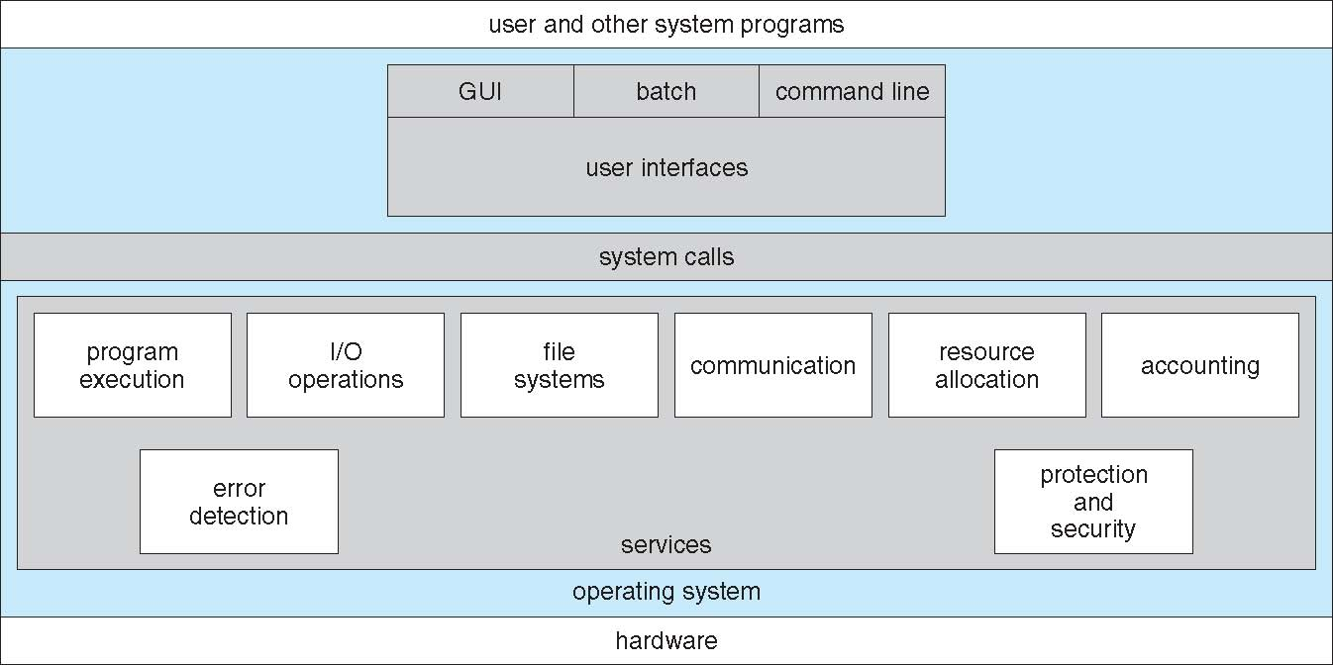
A View of Operating System Services

Slide 5
Operating System Services
Operating systems provide an environment for execution of programs and services to programs and users
One set of operating-system services provides functions that are helpful to the user:
User interface - Almost all operating systems have a user interface (UI).
Command-Line (CLI)
Graphics User Interface (GUI)
Batch
Program execution –
load a program into memory
run that program
end execution, either normally or abnormally (indicating error)
I/O operations - A running program may require I/O, which may involve a file or an I/O device

Slide 6
Operating System Services (Cont.)
One set of operating-system services provides functions that are helpful to the user (Cont.):
File-system manipulation - The file system is of particular interest. Programs need to read and write files and directories, create and delete them, search them, list file Information, permission management.
Communications – Processes may exchange information, on the same computer or between computers over a network
Communications may be via shared memory or through message passing (packets moved by the OS)
Error detection – OS needs to be constantly aware of possible errors
May occur in the CPU and memory hardware, in I/O devices, in user program
For each type of error, OS should take the appropriate action to ensure correct and consistent computing
Debugging facilities can greatly enhance the user’s and programmer’s abilities to efficiently use the system

Slide 7
Operating System Services (Cont.)
Another set of OS functions exists for ensuring the efficient operation of the system itself via resource sharing
Resource allocation - When multiple users or multiple jobs running concurrently, resources must be allocated to each of them
Many types of resources - CPU cycles, main memory, file storage, I/O devices.
Accounting - To keep track of which users use how much and what kinds of computer resources
Protection and security - The owners of information stored in a multiuser or networked computer system may want to control use of that information, concurrent processes should not interfere with each other
Protection involves ensuring that all access to system resources is controlled
Security of the system from outsiders requires user authentication, extends to defending external I/O devices from invalid access attempts

Slide 8
User Operating System Interface - CLI
CLI or command interpreter allows direct command entry
Sometimes implemented in kernel, sometimes by systems program
Sometimes multiple flavors implemented – shells
Fetches a command from user and executes it
Sometimes commands built into the shell and control transfers to the corresponding section within the shell
Sometimes (e.g., UNIX) commands refer to names of programs that implement the function
adding new features doesn’t require shell modification

Slide 9
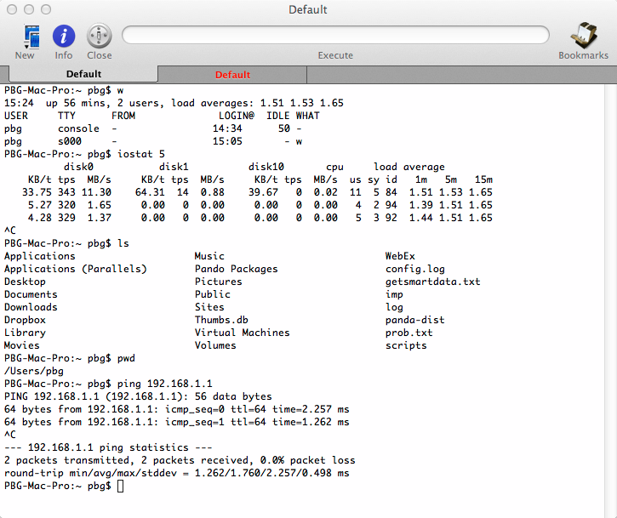
Bourne Shell Command Interpreter

Slide 10
User Operating System Interface - GUI
User-friendly desktop metaphor interface
Usually mouse, keyboard, and monitor
Icons represent files, programs, actions, etc
Various mouse buttons over objects in the interface cause various actions (provide information, options, execute function, open directory (known as a folder)
Invented at Xerox PARC (1973); on the Mac in the ‘80s
Many systems now include both CLI and GUI interfaces
Microsoft Windows is GUI with CLI “command” shell
Apple Mac OS X is “Aqua” GUI interface with UNIX kernel underneath and shells available
Unix and Linux have CLI with optional GUI interfaces (CDE, KDE, GNOME)

Slide 11
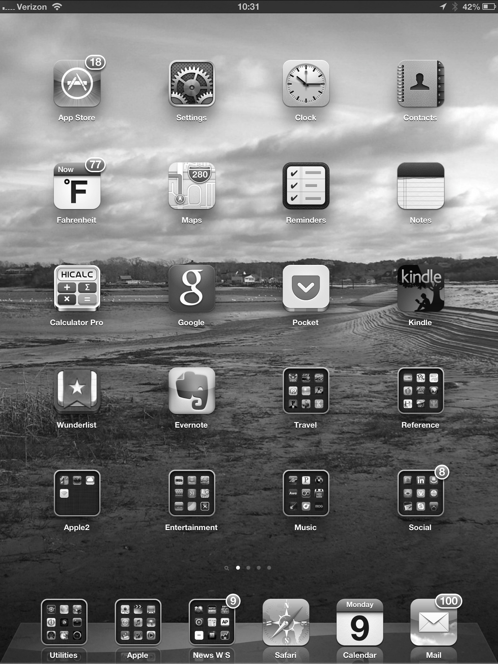
Touchscreen Interfaces
Touchscreen devices require new interfaces
Mouse not possible or not desired
Actions and selection based on gestures
Virtual keyboard for text entry
Voice commands.

Slide 12
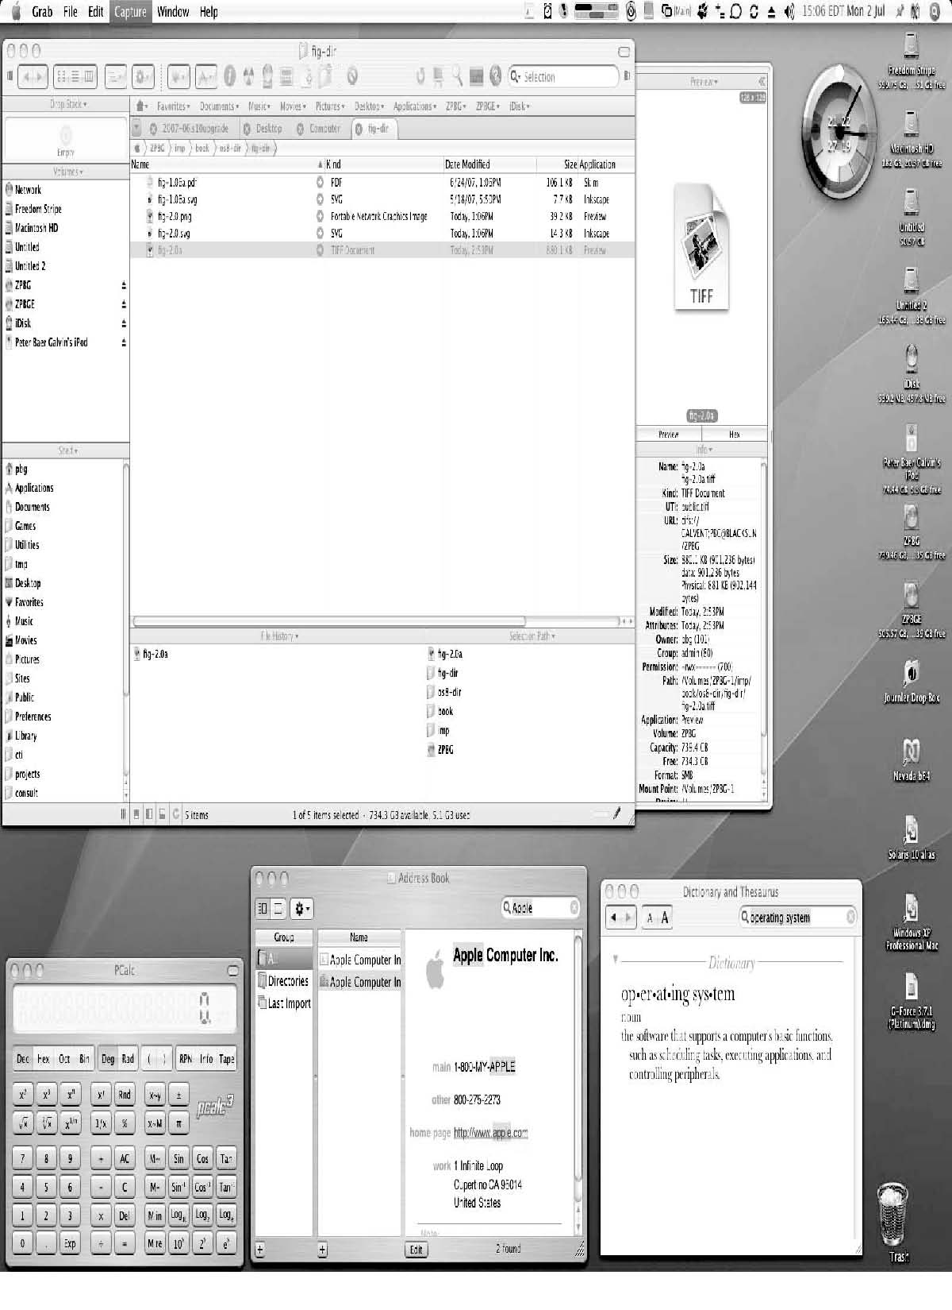
The Mac OS X GUI

Slide 13
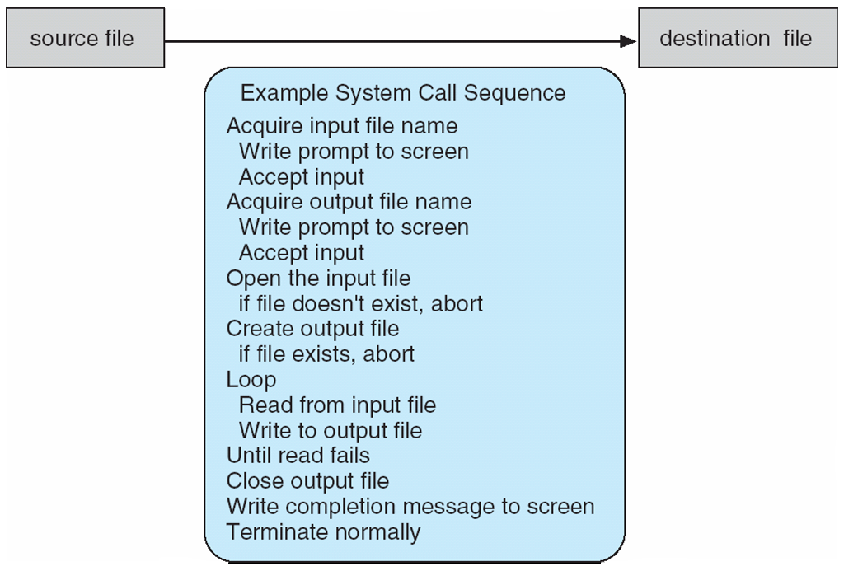
Example of System Calls
System call sequence to copy the contents of one file to another file

Slide 14
System Calls
Programming interface to the services provided by the OS
Typically written in a high-level language (C or C++)
Mostly accessed by programs via a high-level Application Programming Interface (API) rather than direct system call use
Three most common APIs are Win32 API for Windows, POSIX API for POSIX-based systems (including virtually all versions of UNIX, Linux, and Mac OS X), and Java API for the Java virtual machine (JVM)
Note that the system-call names used throughout this text are generic

Slide 15
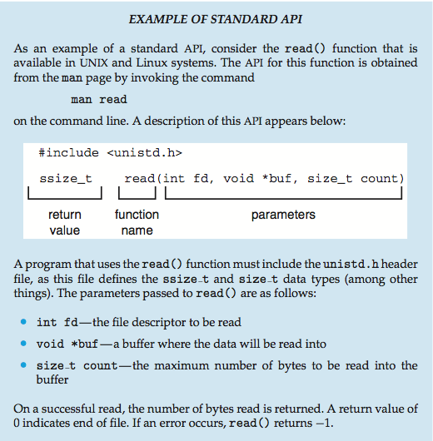
Example of Standard API

Slide 16
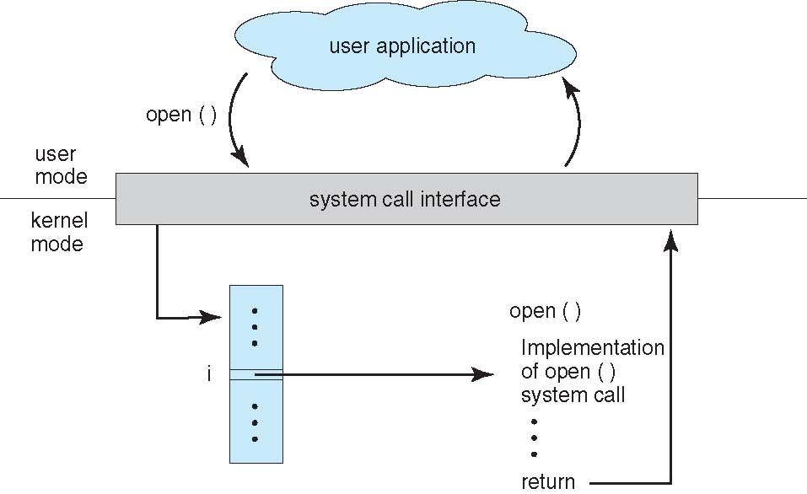
API – System Call – OS Relationship
Provided by the Compiler
Run-time Support system

Slide 17
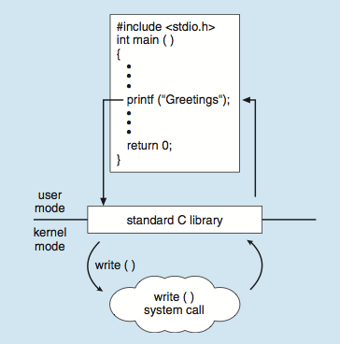
Standard C Library Example
C program invoking printf() library call, which calls write() system call

Slide 18
System Call Implementation
The programmer need know nothing about how the system call is implemented
Just needs to obey API and understand what OS will do as a result
Most details of OS interface hidden from programmer by API
Typically, a number is associated with each system call
System-Call Interface maintains a table indexed according to these numbers
The system call interface invokes the intended system call in OS kernel and returns status of the system call and any return values
System-Call Interface is provided by Compilers as part of the run-time support system (set of functions built into libraries included with compiler),

Slide 19
System Call Parameter Passing
Often, more information is required than just the identity of desired system call
Three general methods used to pass parameters to the OS
Simplest: pass the parameters in registers
In some cases, may be more parameters than registers
Parameters stored in a block, or table, in memory, and address of block passed as a parameter in a register
This approach taken by Linux and Solaris
Parameters placed, or pushed, onto the stack by the program and popped off the stack by the operating system
Block and stack methods do not limit the number or length of parameters being passed

Slide 20
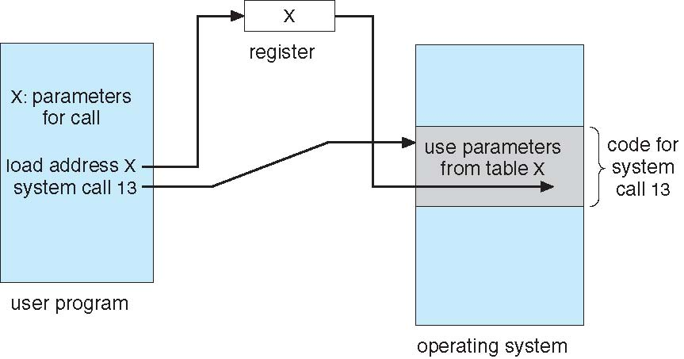
Parameter Passing via Table

Slide 21
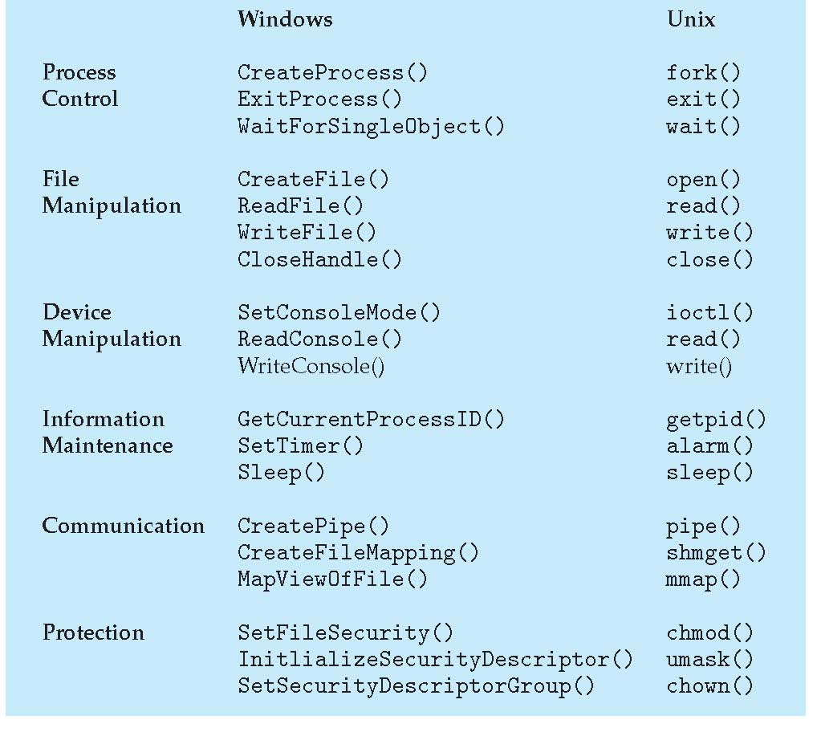
Examples of Windows and Unix System Calls
System Call Categories

Slide 22
Types of System Calls
Process control
create process, terminate process
end, abort
load, execute another program (call/return; concurrent
get process attributes, set process attributes
wait for time
wait event, signal event
allocate and free memory (acquire lock, release lock)
Dump memory if error
Debugger for determining bugs, single step execution
Locks for managing access to shared data between processes

Slide 23
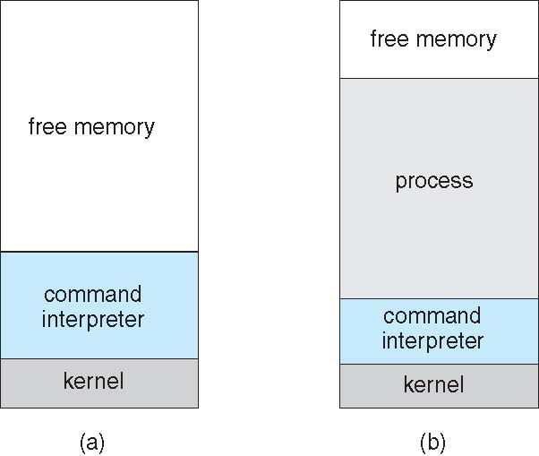
Example: MS-DOS
Single-tasking
Shell invoked when system booted
Simple method to run program
No process created
Single memory space
Loads program into memory, overwriting all but the kernel
Program exit -> shell reloaded
At system startup running a program

Slide 24
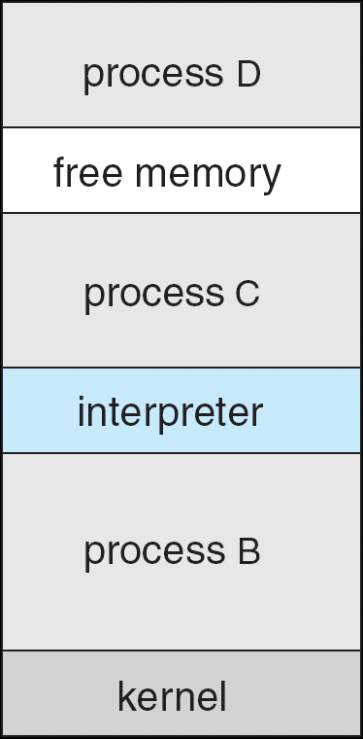
Example: FreeBSD
Unix variant
Multitasking
User login -> invoke user’s choice of shell
Shell executes fork() system call to create process
Executes exec() to load program into process
Shell waits for process to terminate or continues with user commands
Process exits with:
code = 0 – no error
code > 0 – error code

Slide 25
Types of System Calls
File management (applies to directories too, if supported in the OS)
create file, delete file
open, close file
read, write, reposition
get and set file attributes
Move copy
Device management
request device, release device
read, write, reposition
get device attributes, set device attributes
logically attach or detach devices
Sometimes devices and files are managed by the same set of system calls and the UI may allow them to appear similar to the user.

Slide 26
Types of System Calls (Cont.)
Information maintenance
get time or date, set time or date
get system data, set system data
get and set process, file, or device attributes
Dump, single step mode (for debugging)
Program time profiles; Get/Reset Information on processes

Slide 27
Types of System Calls (Cont.)
Communications
create, delete communication connection
In Message-Passing model send, receive messages
host name, network id (if on another computer) or
process name
Originating process - client to Receiving process - server
In Shared-memory model create and gain access to memory regions owned by other processes
Better for high data volume
Maximum data transfer speed and convenience
Requires protocol to prevent simultaneous writes
For low data volume

Slide 28
Types of System Calls (Cont.)
Protection
Control access to resources
Now that all devices are connected, protection issues apply universally to all devices, not just multiprogrammed systems
Get and set permissions of files and disks
Allow and deny user access

Slide 29
System Programs (2.5)
System programs (AKA Utilities) provide a convenient environment for program development and execution. They can be divided into:
File and Directory manipulation
Status information (sometimes stored in a registry)
File modification – text editors; search; text manipulation
Programming language support – compilers, interpreters, assemblers, debuggers
Program loading and execution - (absolute, relocatable, linkage editors, overlay loaders)
Communications - virtual connections – process, user, system) messaging, email, remote login, web browsing, file transfer
Background services
Application programs

Slide 30
System Programs (Cont.)
Background Services
Launch at boot time
Some for system startup, then terminate
Some from system boot to shutdown
Provide facilities like disk checking, process scheduling, error logging, printing
Run in user context not kernel context
Known as services, subsystems, daemons
Application programs
Don’t pertain to system
Run by users
Not typically considered part of OS
Launched by command line, mouse click, finger poke
Includes Web Browsers, word processors, text formatters, spreadsheets, database systems, compilers, plotters, statistical analysis, and games

Slide 31
Operating System Design and Implementation
Design and Implementation of OS not “solvable”, but some approaches have proven successful
Internal structure of different Operating Systems can vary widely
Start the design by defining goals and specifications
Affected by choice of hardware, type of system
User goals and System goals
User goals – operating system should be convenient to use, easy to learn, reliable, safe, and fast
System goals – operating system should be easy to design, implement, and maintain, as well as flexible, reliable, error-free, and efficient

Slide 32
Operating System Design and Implementation (Cont.)
Important principle to separate
Policy: What will be done? Mechanism: How to do it?
Mechanisms determine how to do something, policies decide what will be done
The separation of policy from mechanism is a very important principle, it allows maximum flexibility if policy decisions are to be changed later (example – timer)
Specifying and designing an OS is highly creative task of software engineering

Slide 33
Implementation
Much variation
Early OSes in assembly language
Then system programming languages like Algol, PL/1
Now C, C++
Actually usually a mix of languages
Lowest levels in assembly
Main body in C
Systems programs in C, C++, scripting languages like PERL, Python, shell scripts
More high-level language easier to port to other hardware
But slower
Emulation can allow an OS to run on non-native hardware

Slide 34
Operating System Structure
General-purpose OS is very large program
Requires careful engineering to ensure proper execution and maintainability
Usually modular with well defined inputs, outputs, and functions
Various ways to structure:
Simple structure – MS-DOS
More complex -- UNIX
Layered – an abstraction
Microkernel -Mach

Slide 35
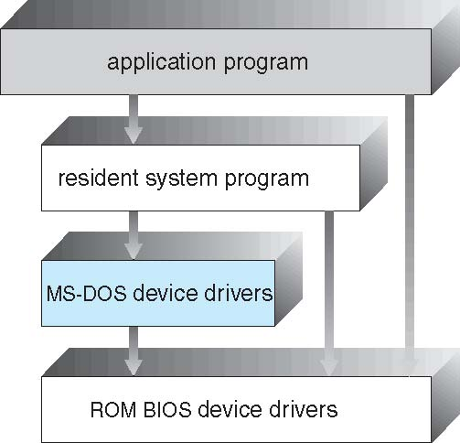
Simple Structure -- MS-DOS
MS-DOS authors had no idea it would become so popular.
MS-DOS – written to provide the most functionality in the least space
Not divided into modules
Although MS-DOS has some structure, its interfaces and levels of functionality are not well separated
Application programs access basic I/O routines to output to display and disks
Vulnerable to system crashes caused by faulty (or malicious) user programs.
Limited by Intel 8088 hardware: no dual mode; no hardware protection

Slide 36
Non Simple Structure -- UNIX
UNIX – limited by hardware functionality, the original UNIX operating system had limited structuring. The UNIX OS consists of two separable parts
Systems programs
The kernel
Consists of everything below the system-call interface and above the physical hardware
Provides the file system, CPU scheduling, memory management, and other operating-system functions; a large number of functions for one level

Slide 37
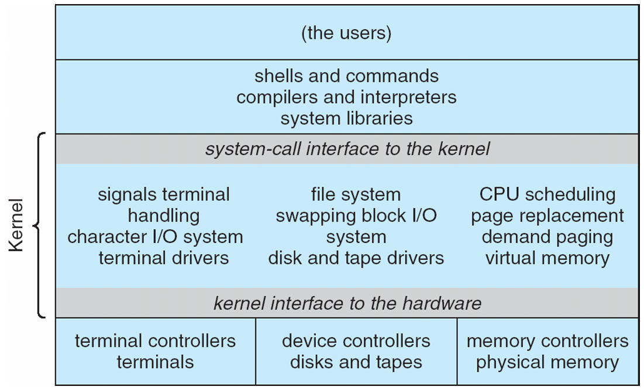
Traditional UNIX System Structure
Beyond simple but not fully layered; constrained by hardware
Hard to implement and Maintain; low overhead within kernel

Slide 38
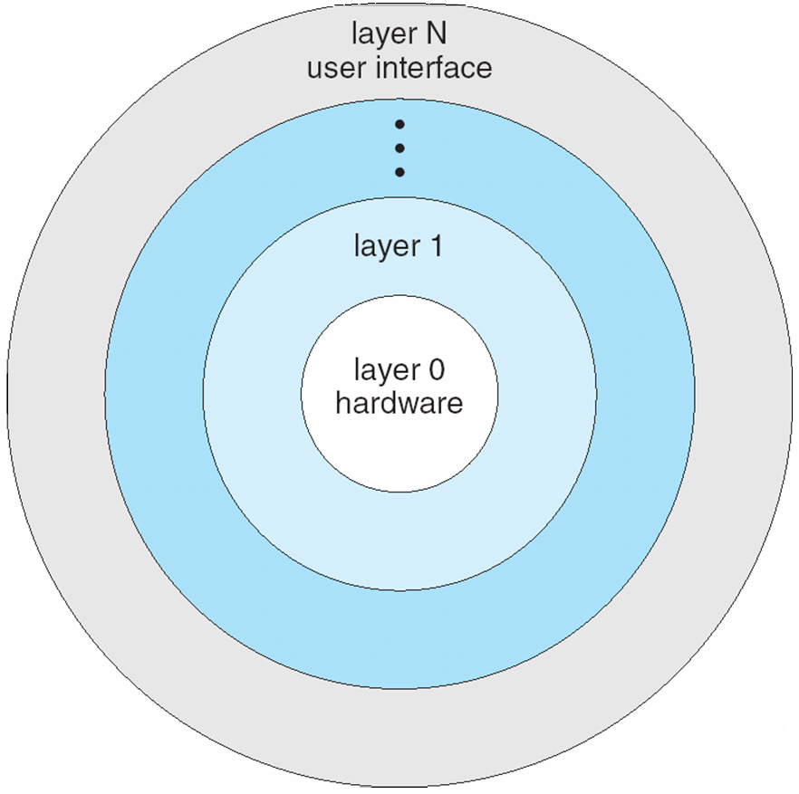
Layered Approach
The operating system is divided into a number of layers (levels), each built on top of lower layers. The bottom layer (layer 0), is the hardware; the highest (layer N) is the user interface.
With modularity, layers are selected such that each uses functions (operations) and services of only lower-level layers
Simple to construct and debug
Start debugging at Layer 1 and work your way up..

Slide 39
Layered Approach Challenges
Appropriate definition of layer contents. Here are some examples:
Backing Store device driver (disk space used for virtual memory algorithms) must be a lower level than memory-management routines since they need access to Backing Store
CPU Scheduler uses Backing Store in larger systems and Backing Store uses CPU Scheduler when waiting for I/O and CPU can be rescheduled to act on other processes.
Typical user program system call involves multiple layers of system calls, each manipulating the parameters and adding delay and overhead.
So…. More recent layered systems have thicker layers with more functionality in each layer.
Creates a balance of modular design and ‘the need for speed’

Slide 40
Microkernel System Structure
Moves as much as possible from the kernel into user space
Mach example of microkernel
Mac OS X kernel (Darwin) partly based on Mach
Communication takes place between user modules using message passing

Slide 41
Microkernel System Structure
Main function of microkernel is communications between client programs and services via message passing.
They never interact directly with each other.

Slide 42
Microkernel System Structure
Easier to extend
New services added to user space and have no impact on microkernel
Easier to port
More security and reliability
Most services are running in user mode. If a service fails the rest of the OS remains untouched.
Suffer from poor performance
Due to increased system-function overhead.
Particularly, the message passing function!!

Slide 43
Modules
Many modern operating systems implement loadable kernel modules (e.g., Linux, Solaris)
Kernel provides core services. Other services are provided dynamically as the kernel is running by linking to other modules (at boot time or during run time).
Linking obviates the need to recompile the kernel every time new features are added.
Kernel can contain CPU Scheduling and Memory Management. File system management for various file systems supported by loadable modules.
Resembles layered system – protected well-defined interfaces
More flexible than layered system – any module can call any other module.
Similar to microkernel approach. Primary module has only core functions but is more efficient since modules need not use message passing to communicate. (So , how DO they communicate?)

Slide 44
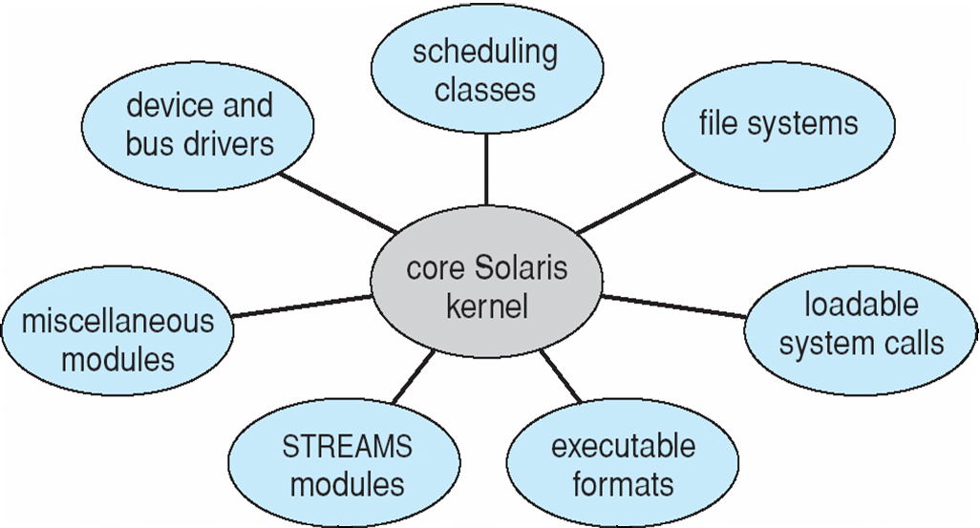
Solaris Modular Approach
A STREAM is a chain of coroutines that pass messages between a program and a device driver (or between a pair of programs)

Slide 45
Hybrid Systems
Most modern operating systems are actually not one pure model
Hybrid combines multiple approaches to address performance, security, usability needs
Linux and Solaris are monolithic with kernels in a single address space for efficiency, plus modular for dynamic loading of functionality
Windows mostly monolithic, plus microkernel for different subsystem personalities that run as user-mode processes.
Apple Mac OS X hybrid, layered, Aqua UI plus Cocoa (Objective-C) programming environment for writing Mac OS X applications.
Below is kernel consisting of Mach microkernel and BSD Unix parts, plus I/O kit and dynamically loadable modules (called kernel extensions)
Notes:
The primary operating system personality on Windows is the Windows API, which is always
present. The emulation subsystem which implements the Windows personality is called the
Client/Server Runtime Subsystem (csrss.exe).
On versions of NT prior to 4.0, this subsystem process also contained the window manager,
graphics device interface and graphics device drivers. For performance reasons, however,
in version 4.0 and later, these modules (which are often implemented in user mode even on
monolithic systems, especially those designed without internal graphics support) run as a
kernel-mode subsystem.^{[2]}
As of 2007, one other operating system personality, UNIX, is offered as an optionally installed
system component on certain versions of Windows Vista and Windows Server 2003 R2.
The associated subsystem process is the Subsystem for UNIX-Based Applications (psxss.exe),
which was formerly part of a Windows add-on called Windows Services for UNIX.
An OS/2 subsystem (os2ss.exe) was supported in older versions of Windows NT, as was a very
limited POSIX subsystem (psxss.exe). The POSIX subsystem was supplanted by the
UNIX subsystem, hence the identical executable name.^{[4]}Applications that run on NT
are written to one of the OS personalities (usually the Windows API), and not to the native
NT API for which documentation is not publicly available (with the exception of routines
used in device driver development). An OS personality is implemented via a set of user-mode
DLLs (see Dynamic-link library), which are mapped into application processes' address spaces
as required, together with an emulation subsystem server process (as described previously).
Applications access system services by calling into the OS personality
DLLs mapped into their address spaces, which in turn call into the
NT run-time library (ntdll.dll), also mapped into the process address space.

Slide 46
Mac OS X Structure
BSD CLI
POSIX APIs
Networking and file systems
IPC facilities: message passing, thread scheduling
Memory mgt. for RPC
BSD= Berkeley Software Distribution
Notes:
POSIX Threads, usually referred to as Pthreads, is an execution model that
exists independently from a language, as well as a parallel execution model.
It allows a program to control multiple different flows of work that overlap
in time. Each flow of work is referred to as a thread, and creation and control
over these flows is achieved by making calls to the POSIX Threads API.
API are used for thread creation and synchronization

Slide 47
iOS
Apple mobile OS for iPhone, iPad
Structured on Mac OS X, added functionality
Does not run OS X applications natively
Also runs on different CPU architecture (ARM vs. Intel)
Cocoa Touch Objective-C API for developing apps unique to mobile devices
Media services layer for graphics, audio, video
Core services provides features including cloud computing, databases
Core operating system, based on Mac OS X kernel

Slide 48
Android
Developed by Open Handset Alliance (mostly Google)
Open Source
Runs on a variety of mobile platforms
Similar stack to IOS
Based on Linux kernel but modified
Provides process, memory, device-driver management
Adds power management
Runtime environment includes core set of libraries and Dalvik virtual machine (designed specifically for mobile devices)
Apps developed in Java plus Android API
Java class files compiled to Java bytecode then translated to executable than runs in Dalvik VM
Libraries include frameworks for web browser (webkit), database (SQLite), multimedia, smaller C Library (libc) designed for the slower CPUs in mobile devices.

Slide 49
Android Architecture

Slide 50
Operating-System Debugging
Debugging is finding and fixing errors, or bugs and performance bottlenecks.
Failure Analysis
OS generate log files containing error information
Failure of an application can generate core dump file capturing memory of the process
Debuggers can be used to probe running programs and core dumps
Operating system failures are crashes and generate crash dump files containing kernel memory
Debugging methods for OS and for user processes have fundamental differences.
A failure in the file-system kernel code can’t use the file system to save its state before rebooting while a user process can very safely do that.

Slide 51
Operating-System Debugging
Performance Tuning
Beyond crashes, performance tuning can optimize system performance
Sometimes using trace listings of activities, recorded for analysis including timing and important parameters
Profiling is periodic sampling of instruction pointer to look for statistical trends
Kernighan’s Law: “Debugging is twice as hard as writing the code in the first place. Therefore, if you write the code as cleverly as possible, you are, by definition, not smart enough to debug it.”

Slide 52
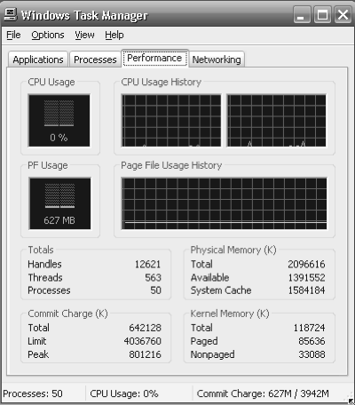
Performance Tuning
Improve performance by removing bottlenecks
OS must provide means of computing and displaying measures of system behavior
For example, UNIX “top” program or Windows Task Manager

Slide 53
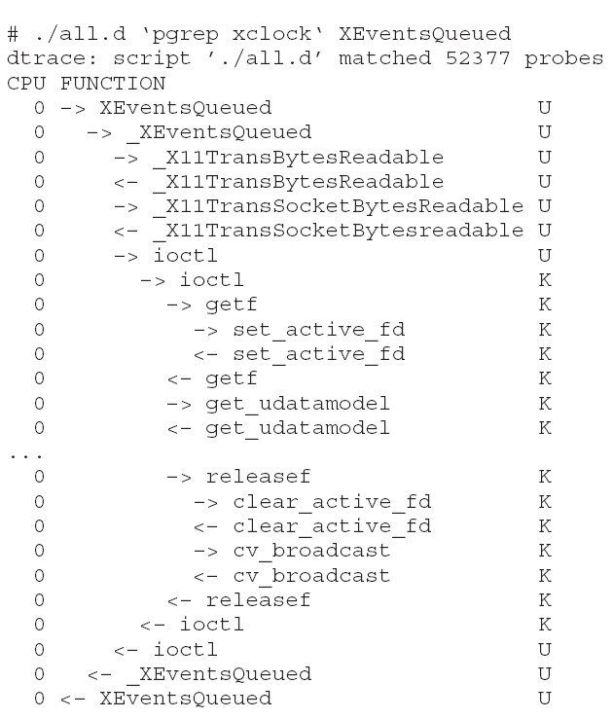
DTrace
DTrace tool in Solaris, FreeBSD, Mac OS X allows live instrumentation on production systems
Probes fire when code is executed within a provider, capturing state data and sending it to consumers of those probes
Example of following XEventsQueued system call move from libc library to kernel and back

Slide 54
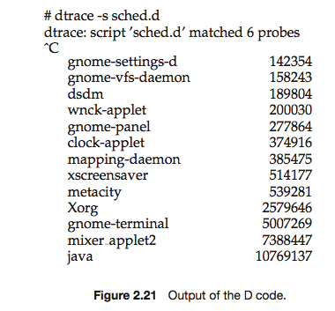
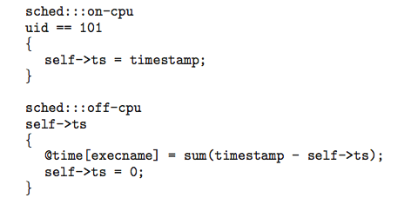
Dtrace (Cont.)
DTrace code to record amount of time each process with UserID 101 is in running mode (on CPU) in nanoseconds

Slide 55
Operating System Generation
Operating systems are designed to run on any of a class of machines; the system must be configured for each specific computer site
SYSGEN program obtains information concerning the specific configuration of the hardware system
Used to build system-specific compiled kernel or system-tuned
Can general more efficient code than one general kernel

Slide 56
System Boot
When power initialized on system, execution starts at a fixed memory location
Firmware ROM used to hold initial boot code
Operating system must be made available to hardware so hardware can start it
Small piece of code – bootstrap loader, stored in ROM or EEPROM locates the kernel, loads it into memory, and starts it
Sometimes two-step process where boot block at fixed location loaded by ROM code, which loads bootstrap loader from disk
Common bootstrap loader, GRUB, allows selection of kernel from multiple disks, versions, kernel options
Kernel loads and system is then running

Slide 57
End of Chapter 2

